Slide 1

Leveling The Playing
Field

Slide 2
Who are we:
Team Lead: Kristina-
Frontend/Backend
Team Members:
Areli-
Frontend/Backend
Matt-
Backend
Mark-
Backend

Slide 3
Problem & Goal
MLB Players go through contract negotiations with team’s front offices.
Some Athletes are overpaid, and others underpaid.
The goal is to calculate a universal salary for athletes in the MLB
Salary based on individual player stats
Use listed salary made from 2018
Instill our algorithm to calculate the players ideal salary based on their stats

Slide 4
Consumers
Main Consumers
Team managers
Third party agencies
Individual players’ agents

Slide 5
Technologies we are using
We are using C# with ASP.NET Core as our Framework
Razor Pages
MySql database
HTML and CSS
GitHub

Slide 6
Razor Page vs MVC
Razor
new feature in ASP.NET Core 2.0
Simple way to organize code within ASP.NET Core applications
@page with a .cshtml extension
MVC
3 Root Level Folders
/Controllers/CartController.cs
/ViewModels/CartViewModel.cs
/Views/Cart/Index.cshtml
Razor Pages has 1 Root Level Folder
/Pages/Cart/Index.cshtml

Slide 7
.cshtml
.cshtml.cs
@page
@model
Html syntax
asp-for= “”
Namespace
Model
Tag Helpers
public [data type] [nameOfObject] {get; set;}
OnPost()
Method
OnGet()

Slide 8
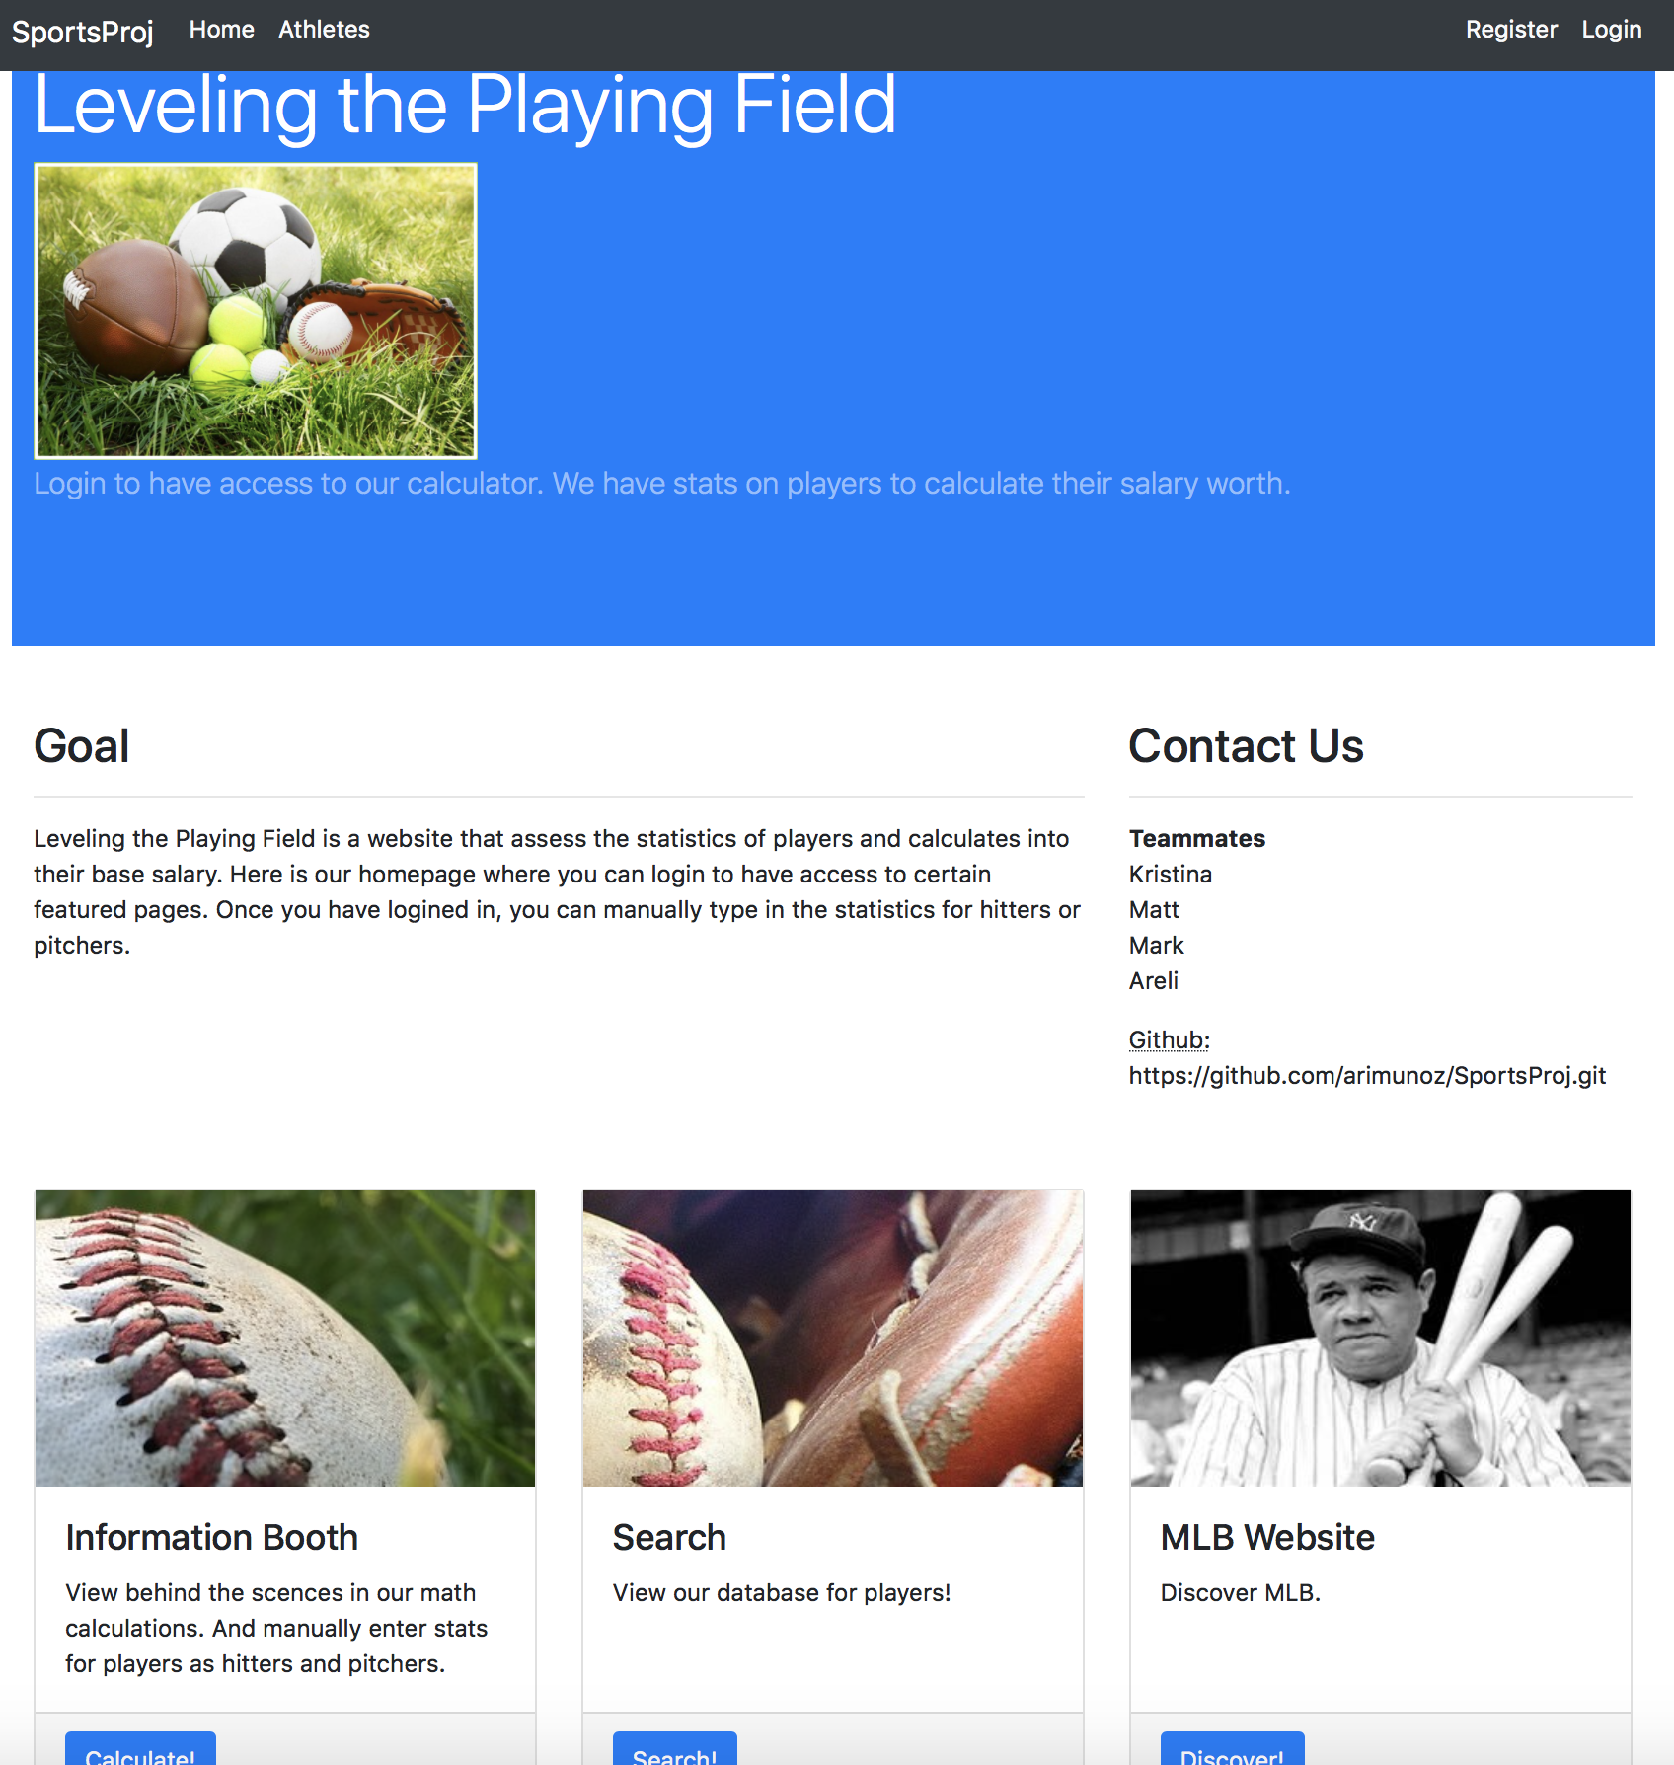
WEBSITE PROJECT
FEATURES:
LOGIN
REGISTER
SEARCH
MANUAL CALCULATOR
ETC...

Slide 9
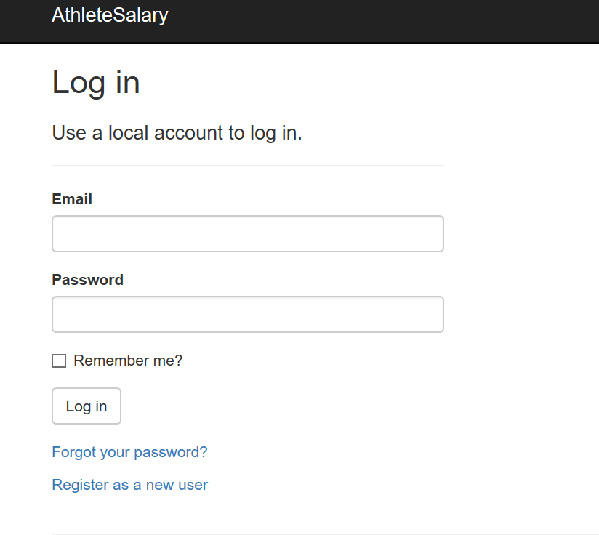
1.
LOGIN

Slide 10
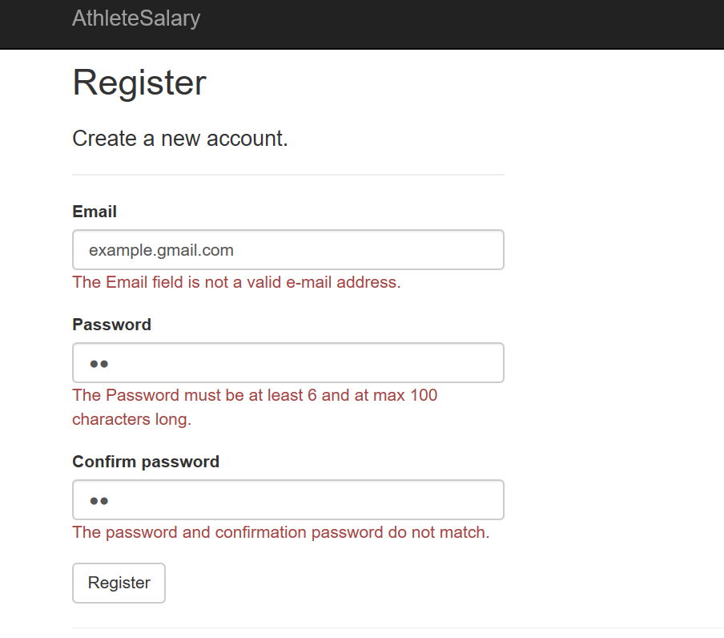
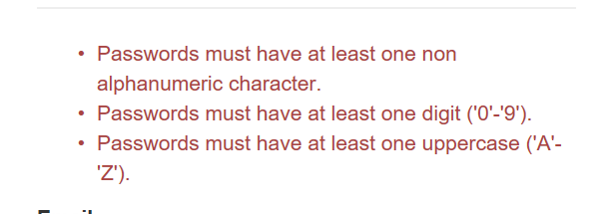
2.
REGISTER

Slide 11
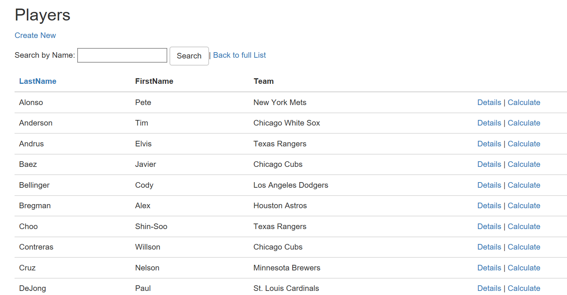
3.
SEARCH

Slide 12
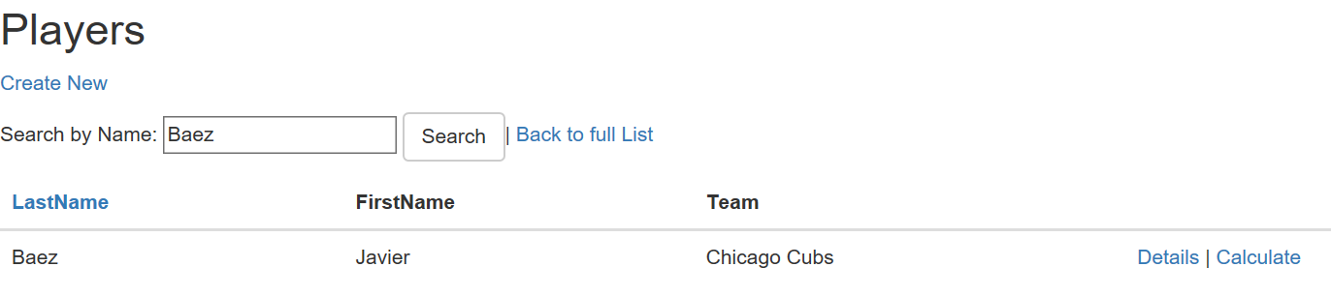
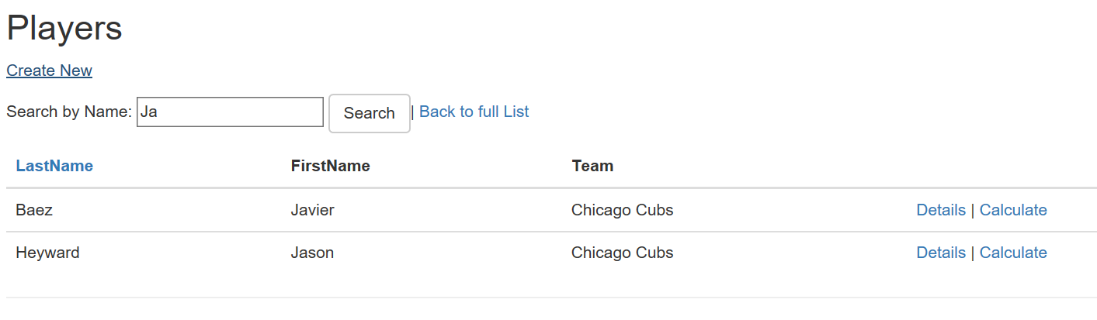

Slide 13
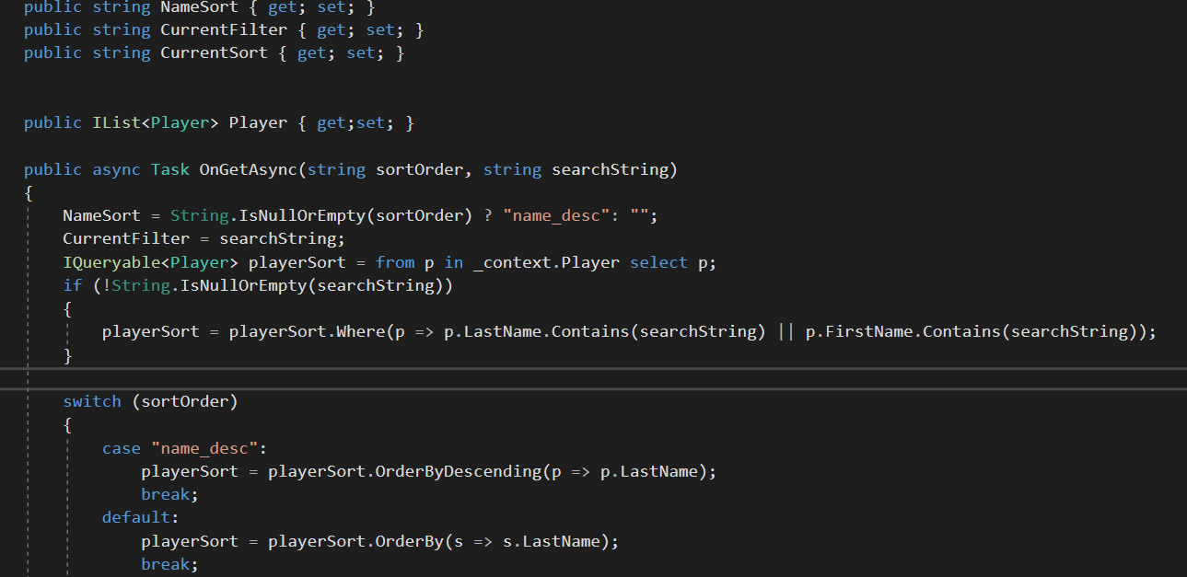

Slide 14
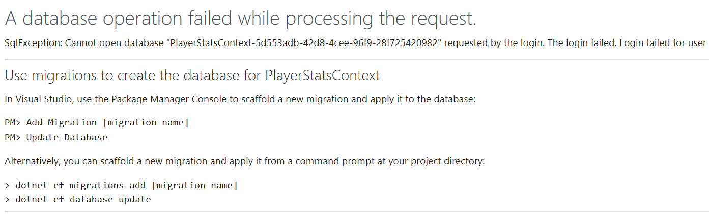
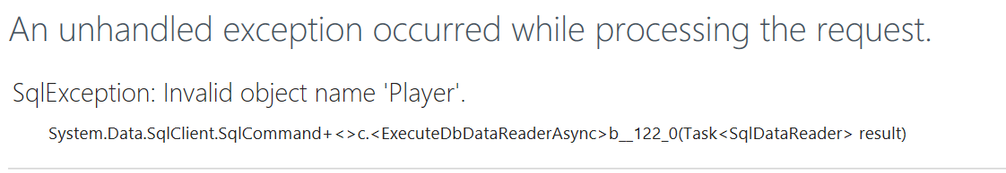
Errors
Two database contexts
Due to multiple scaffolds
Invalid object name
Added a column variable after scaffold
Visual Studio Mac
Does not internally include SQL Server Object Explorer

Slide 15
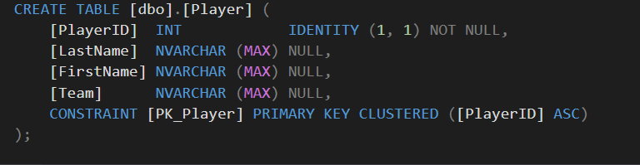
Players Table

Slide 16
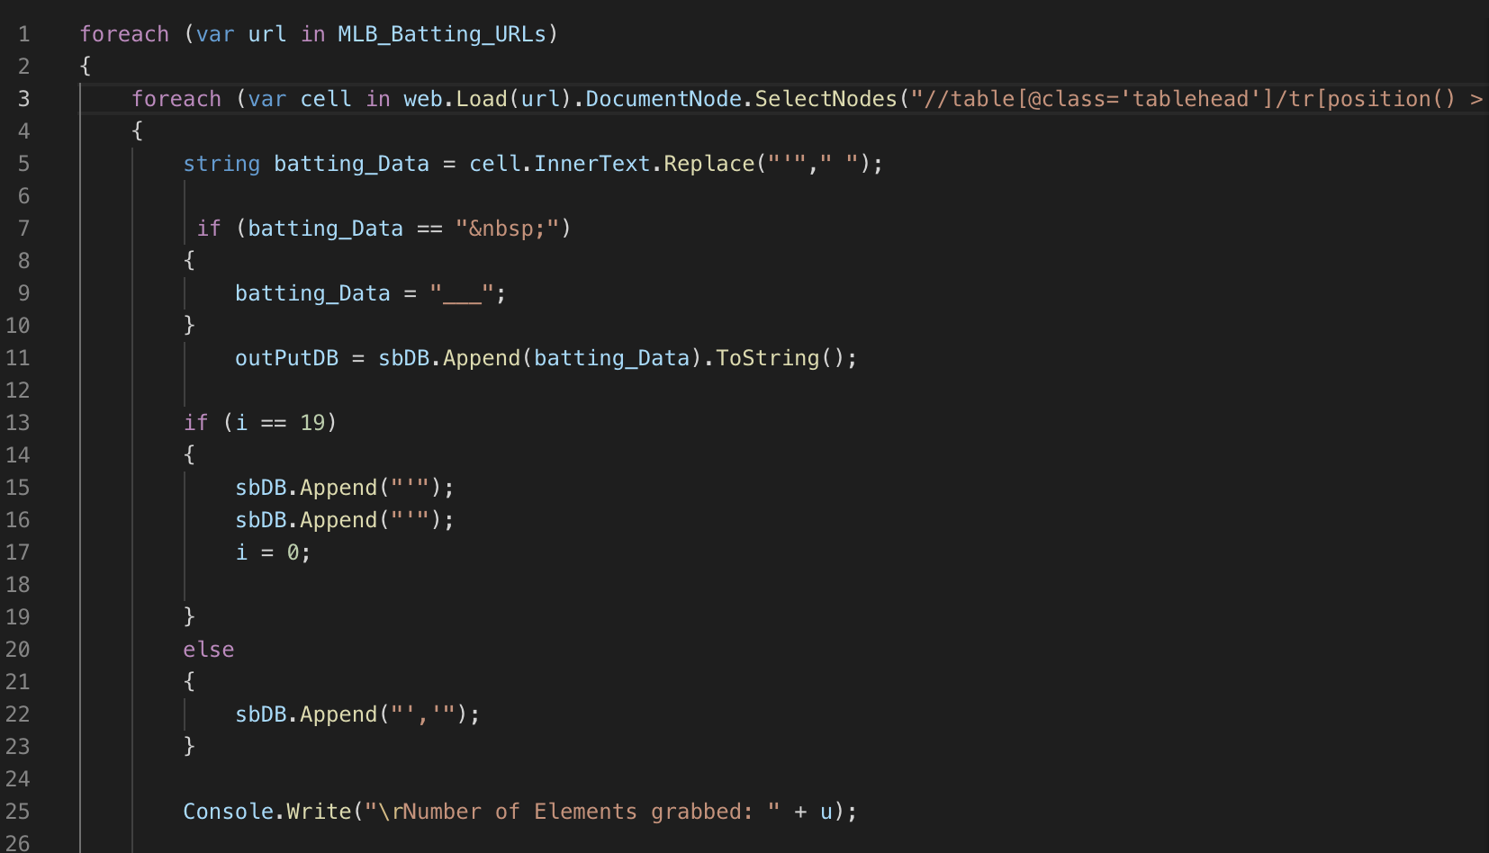
WEBCRAWLER

Slide 17
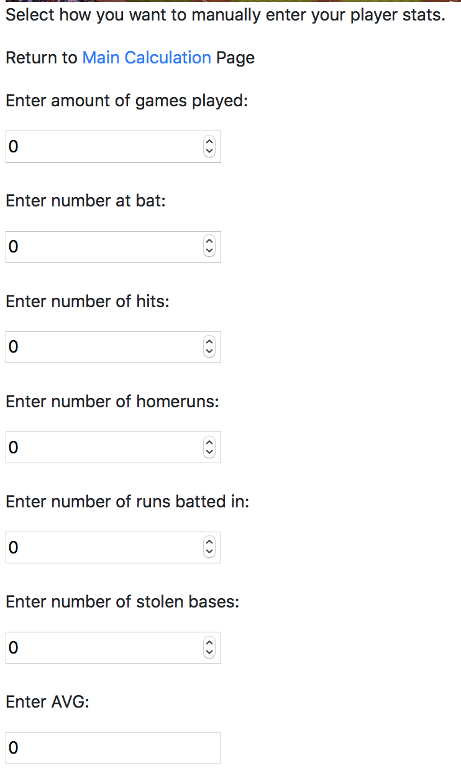
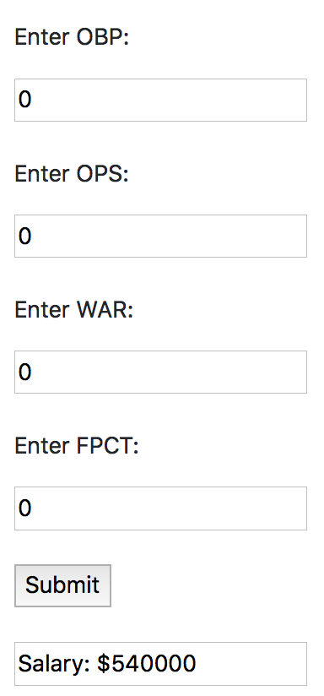
4.
MANUAL
CALCULATION

Slide 18
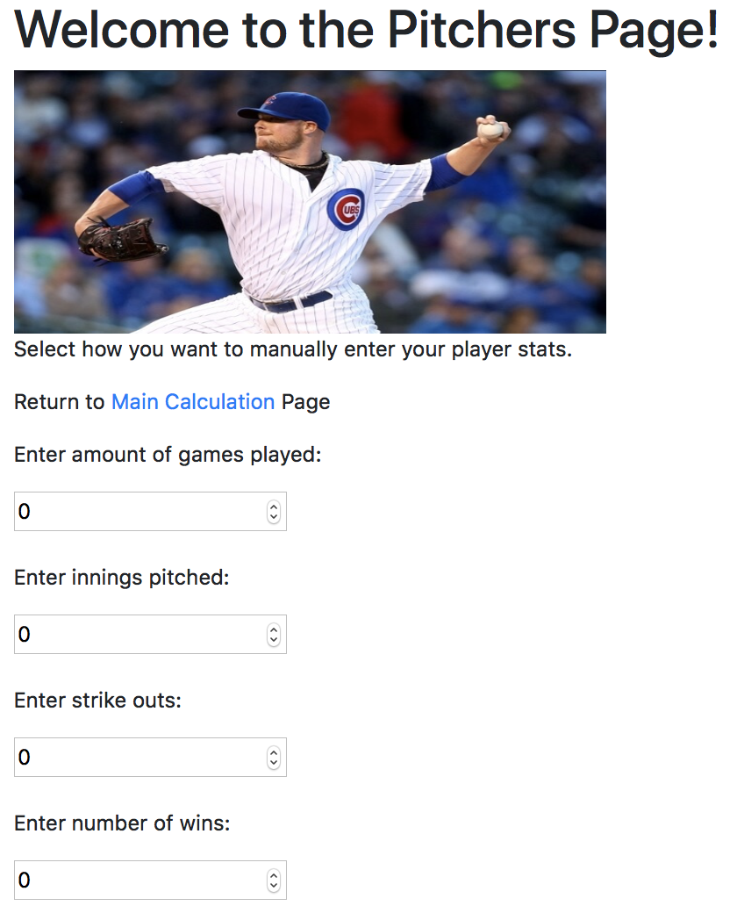
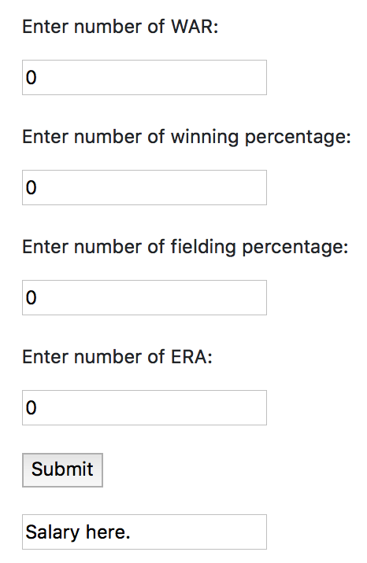

Slide 19
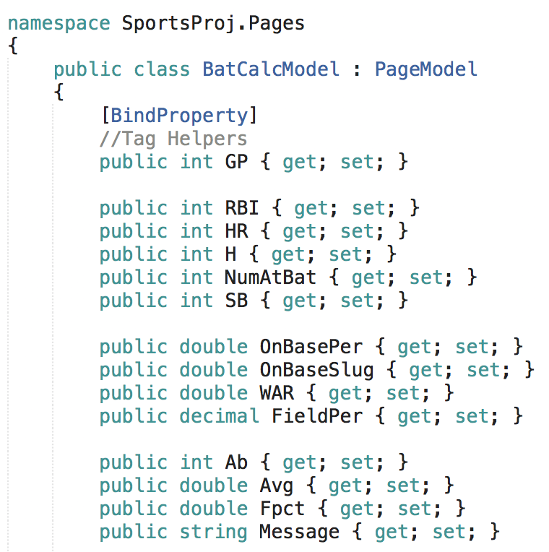
Hitters Code
Namespace
Model
Tag Helpers
public [data type] [nameOfObject] {get; set;}
OnPost()
Method
OnGet()

Slide 20
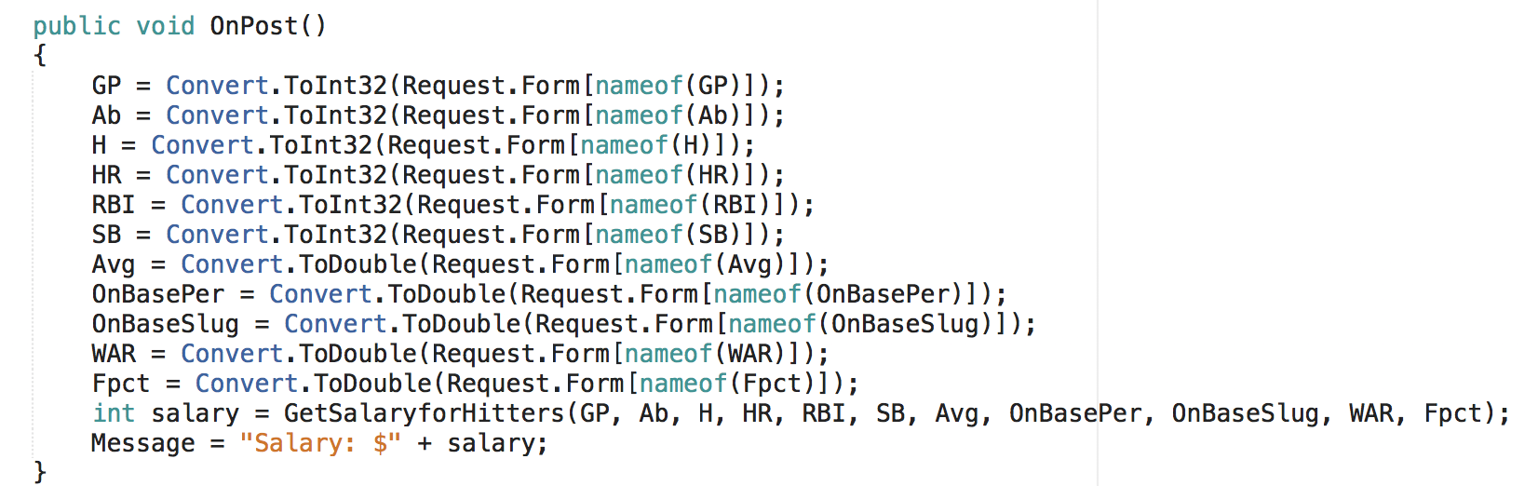
Hitters Code
public [data type] [nameOfObject] {get; set;}
OnPost()

Slide 21
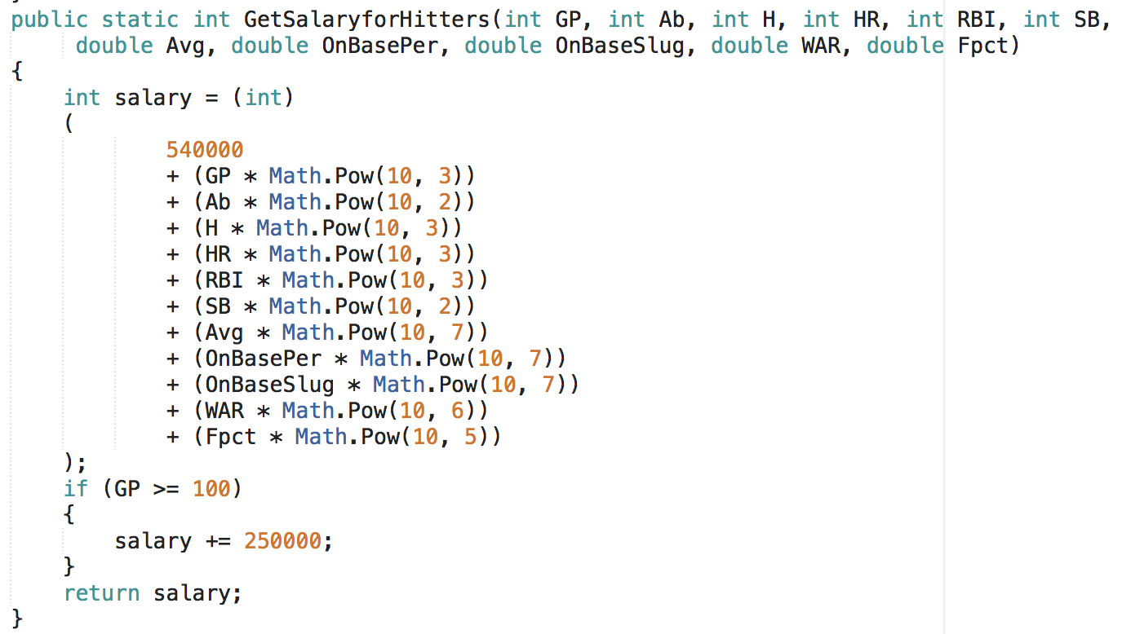
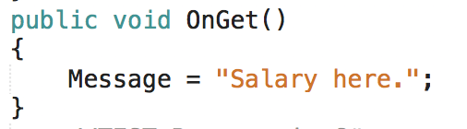
Hitters Code
Method
OnGet()

Slide 22
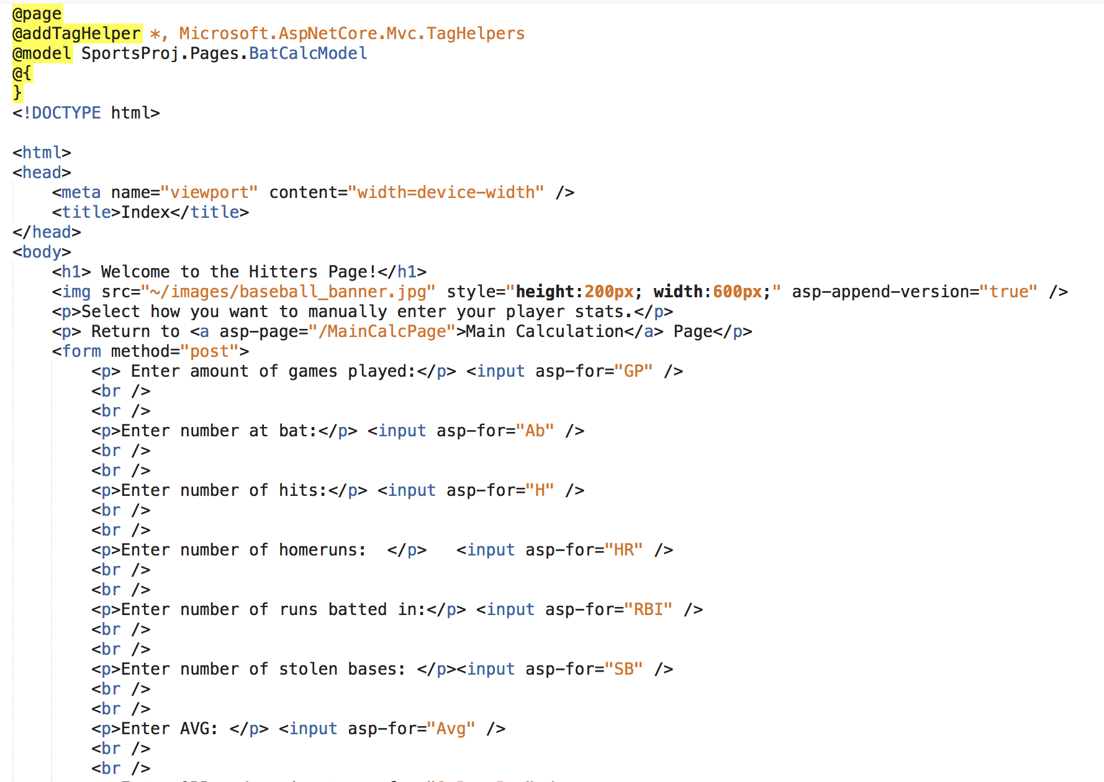
Hitters Code
.cshtml

Slide 23
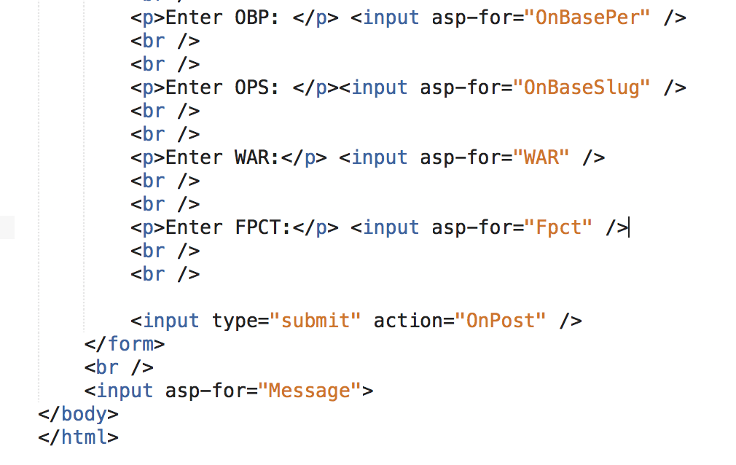
Hitters Code
.cshtml

Slide 24
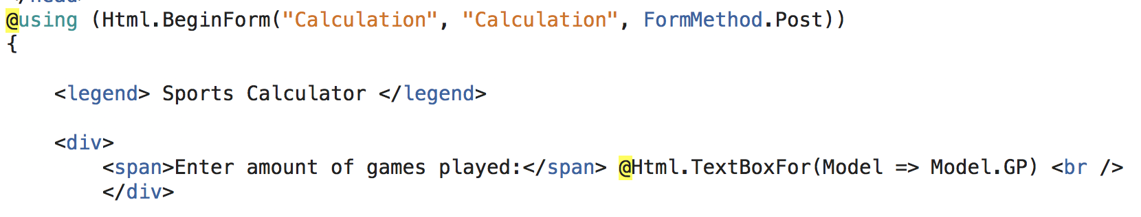
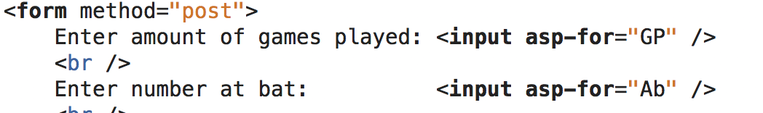
Razor Syntax Errors:

Slide 25
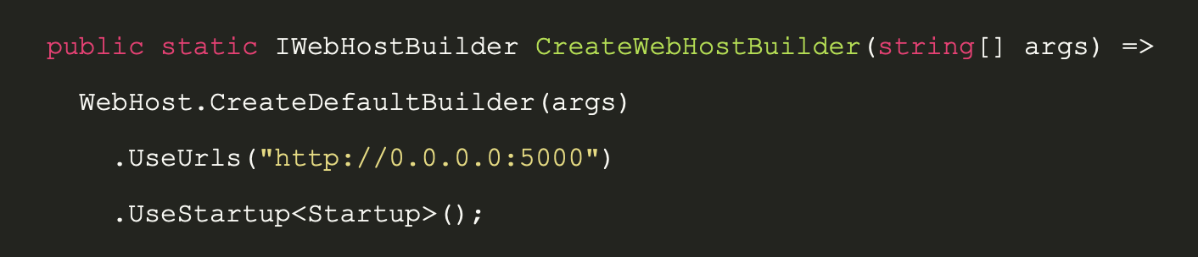

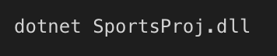
Hosting to Server

Slide 26
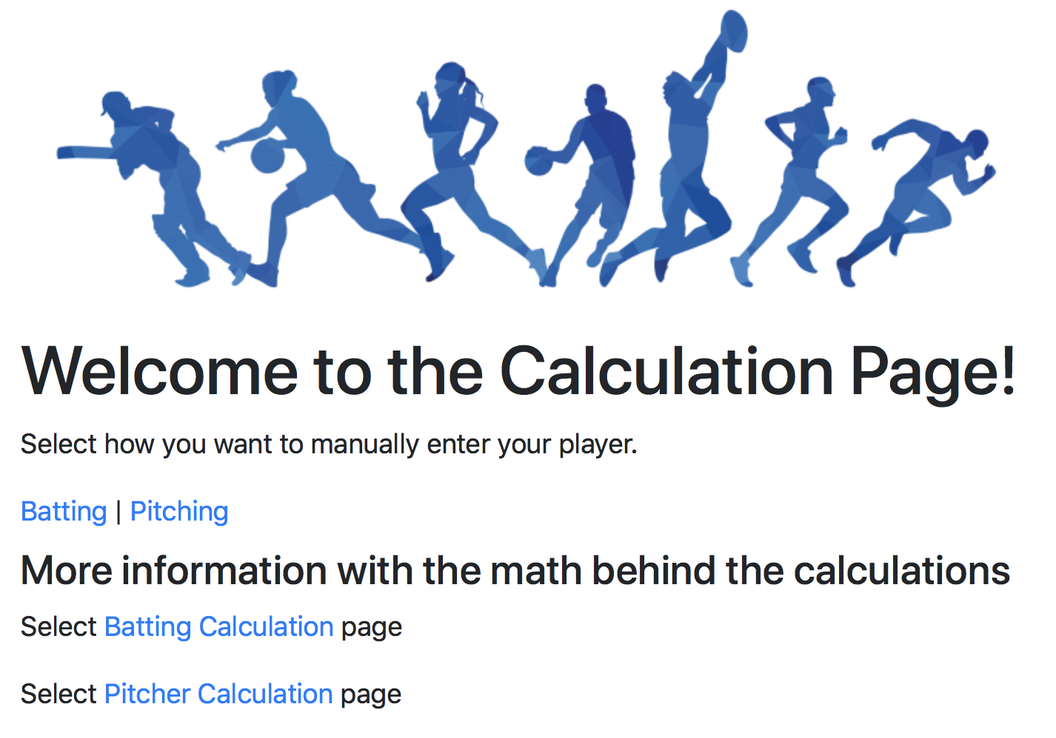

Slide 27
$ 540,000
Base Salary:2018 - www.baseball-reference.com

Slide 28
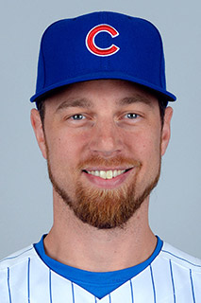

HITTER TEST CASES
Ben Zobrist
Anthony Rizzo
Actual 2018: $16,500,000
Actual 2018: $7,285,714
Calculated 2018: $19,579,900
Calculated 2018: $15,085,000
Source: baseball-reference.com

Slide 29
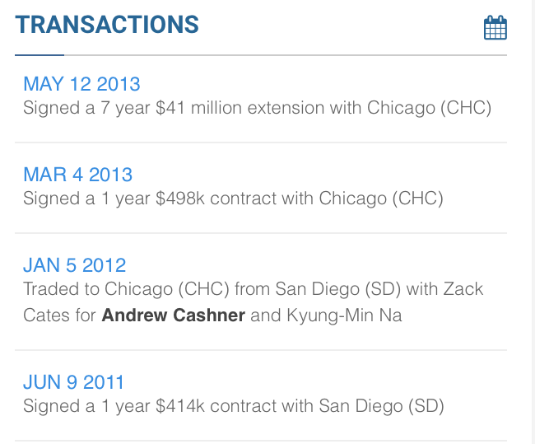
HITTER TEST CASES
Anthony Rizzo
Actual 2018: $7,285,714
Calculated 2018: $15,085,000
Source: baseball-reference.com

Slide 30


PITCHER TEST CASES
Jon Lester
Kyle Hendricks
Actual 2018: $22,500,000
Actual 2018: $4,175,000
Calculated 2018: $7,716,200
Calculated 2018: $8,043,978
Source: baseball-reference.com

Slide 31
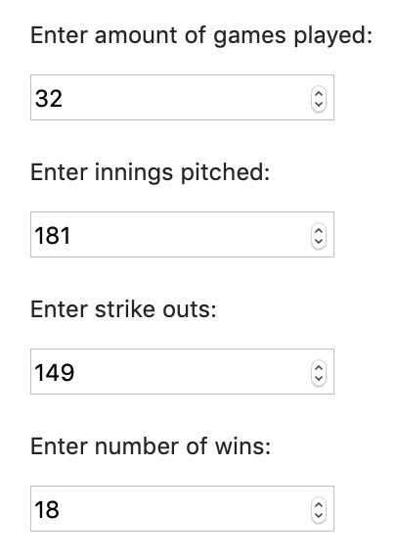
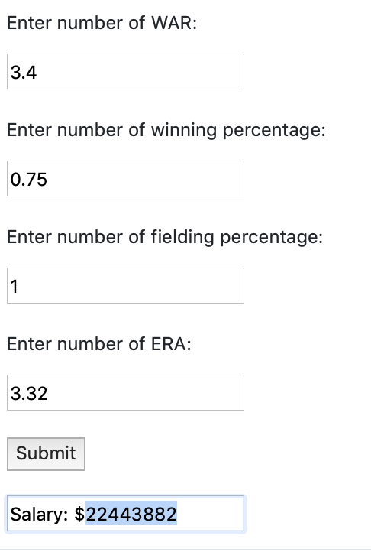
PITCHER TEST CASES
Jon Lester
Actual 2018: $22,500,000
Calculated 2018: $22,443,882
Source: baseball-reference.com

Slide 32

Why Contracts Matter
Clayton KerShaw
Clayton KerShaw
2014 Led the league
Wins
Winning percentage
ERA
Allstar and was the MVP of the League
Actual 2014: $6,571,000
LPF 2014: $29,779,202
Actual 2015: $35,000,000
LPF 2018: $21,409,282
Source: baseball-reference.com

Slide 33
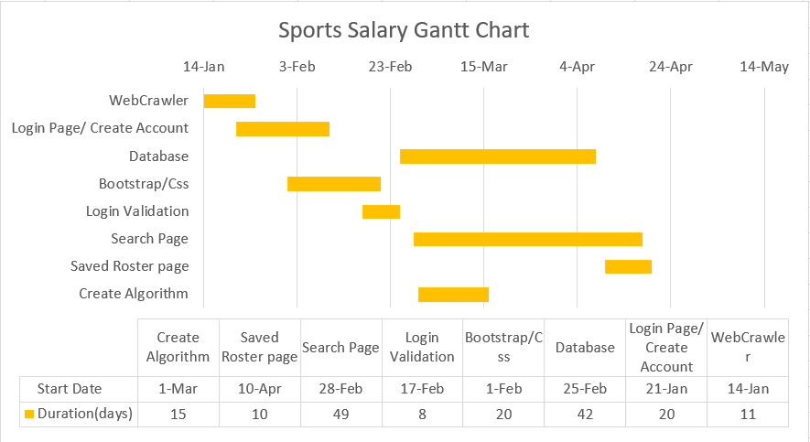

Slide 34
Next Steps
Fix VS Mac Sql Server Object Explorer issue
Implement Saved Roster Feature
Players positions
Webcrawler database connection

Slide 35
CREDITS
https://docs.microsoft.com/en-us/dotnet/csharp/
https://docs.microsoft.com/en-us/aspnet/core/tutorials/razor-pages/sql?view=aspnetcore-2.2&tabs=visual-studio
https://msdn.microsoft.com/en-us/magazine/mt842512.aspx
Baseball Stats Information:
https://www.baseball-reference.com/

Slide 36
THANKS!
Hosted @
http://45.55.137.42:5000
Any questions?
DEMO Time!

Slide 37
SlidesCarnival icons are editable shapes.
This means that you can:
Resize them without losing quality.
Change line color, width and style.
Isn’t that nice? :)
Examples:

Slide 38
😉
Now you can use any emoji as an icon!
And of course it resizes without losing quality and you can change the color.
How? Follow Google instructions https://twitter.com/googledocs/status/730087240156643328
✋👆👉👍👤👦👧👨👩👪💃🏃💑❤😂😉😋😒😭👶😸🐟🍒🍔💣📌📖🔨🎃🎈🎨🏈🏰🌏🔌🔑 and many more...

